Slide 1

SANCHAYA
NAYANA U
MES24MCA-2041
Department of Computer Applications
MES College of Engineering, Kuttippuram
20-7-2025

Slide 2
PRODUCT OWNER Mr.NOWSHAD CV Assistant Professor DEPARTMENT OF COMPUTER APPLICATIONS MES COLLEGE OF ENGINEERING, KUTTIPPURAM

Slide 3
TABLE OF CONTENTS
Introduction
Objective
Existing System
Proposed System
Motivation
Functionalities
Module Description
Developing Environment
Sprint Backlog
Product Backlog
User Story
Project Plans
Data Flow Diagrams
ER Diagram

Slide 4
SANCHAYA
Sanchaya is a flutter based mobile app for food donation and redistribution.
Aims to bridge the gap between surplus food sources and people in need.
Enables donors (restaurants, event organizers, households) to post available food.
Registered volunteers and NGOs can view and claim food in real-time.
Supports geolocation tagging, food expiry alerts, and photo uploads.
Promotes a sustainable, zero-waste food culture in Kerala.
Multilingual support: Malayalam and English for wider usability.

Slide 5
OBJECTIVES
vggfhguh

Slide 6
EXISTING SYSTEM
Write Existing system using bullet points (1 Slide)

Slide 7
PROPOSED SYSTEM
Write Proposed system using bullet points (1 Slide)

Slide 8
MOTIVATIONS
Write Project Motivations using bullet points (1 Slide)

Slide 9
FUNCTIONALITIES
Write Project Functionalities with short description using bullet points (1 to 2 Slide)

Slide 10
MODULE DESCRIPTION
Write Module Descriptions using bullet points (1 to 2 Slide)

Slide 11
DEVELOPING ENVIRONMENT
Write the software tools/technologies used for developing the project like Operating System, Front End, Back End, Database, Framework, IDE etc..

Slide 12
SPRINT BACKLOG
Backlog tem | Status And Completion Date | Original Estimation in Hours | Day 1 hrs | Day 2 hrs | Day 3 hrs | Day 4 hrs | Day 5 hrs | Day 6 hrs | Day 7 hrs | Day 8 hrs | Day 9 hrs | Day 10 hrs
SPRINT1
Table designing | 16/8/2022 | 2 | 1 | 1 | 0 | 0 | 0 | 0 | 0 | 0 | 0 | 0
Form designing | 22/8/2022 | 3 | 1 | 1 | 1 | 0 | 0 | 0 | 0 | 0 | 0 | 0
Coding | 27/8/2022 | 3 | 1 | 1 | 1 | 0 | 0 | 0 | 0 | 0 | 0 | 0
SPRINT 2
Data collection | 13/9/2022 | 7 | 1 | 1 | 1 | 1 | 1 | 1 | 1 | 0 | 0 | 0
Data processing | 29/9/2022 | 7 | 1 | 1 | 1 | 1 | 1 | 1 | 1 | 0 | 0 | 0
The table given above is for reference only. Update/create a table with your data.

Slide 13
SPRINT BACKLOG
Backlog tem | Status And Completion Date | Original Estimation in Hours | Day 1 hrs | Day 2 hrs | Day 3 hrs | Day 4 hrs | Day 5 hrs | Day 6 hrs | Day 7 hrs | Day 8 hrs | Day 9 hrs | Day 10 hrs
SPRINT3
Course contents | 3/10/2022 | 7 | 1 | 1 | 1 | 1 | 1 | 1 | 1 | 0 | 0 | 0
Assassement | 20/10/2022 | 7 | 1 | 1 | 1 | 1 | 1 | 1 | 1 | 0 | 0 | 0
SPRINT 4
Certificate | 8/11/2022 | 7 | 1 | 1 | 1 | 1 | 1 | 1 | 1 | 0 | 0 | 0
Testing | 15/11/2022 | 7 | 1 | 1 | 1 | 1 | 1 | 1 | 1 | 0 | 0 | 0
TOTAL |  | 50 | 9 | 9 | 8 | 6 | 6 | 6 | 6
The table given above is for reference only. Update/create a table with your data.

Slide 14
PRODUCT BACKLOG
ID | NAME | PRIORITY <high/medium/low> | ESTIMATE (Hours) | STATUS <Planned/In progress/Completed>
1 | REGISTRATION | High | 5 | COMPLETED
2 | LOGIN | High | 5 | COMPLETED
3 | CRUD(Course,Student,University) OPERATIONS | High | 20 | COMPLETED
4 | STUDENT ENROLLMENT | High | 10 | COMPLETED
5 | CERTIFICATE GENERATION | MEDIUM | 10 | COMPLETED
The table given above is for reference only. Update/create a table with your data.

Slide 15
USER STORY
User Story ID | As a type of User | I want to <Perform some task> | So that i can <Achieve Some Goal>
1 | ADMIN | Login | login successful with correct username and password
2 | ADMIN | View and Manage | Can view and Manage registered users,Faculties and Universities
3 | ADMIN | Verification | Verify Courses
4 | USER | Register | Can users register
5 | USER | Login | login successful with correct username and password
6 | USER | Enrollment | Can enroll in any Courses
7 | USER | View Profile | View users profile in application
The table given above is for reference only. Update/create a table with your data.

Slide 16
PROJECT PLAN
User StoryID | Task Name | Start Date | End Date | Days | Status
1 | Sprint 1 | 16/08/2022 | 17/08/2022 | 10 | Completed
4 |  | 18/08/2022 | 19/08/2022 |  | Completed
5 |  | 20/08/2022 | 22/08/2022 |  | Completed
10 |  | 23/08/2022 | 24/08/2022 |  | Completed
11 |  | 25/08/2022 | 27/08/2022 |  | Completed
2 | Sprint 2 | 13/09/2022 | 23/09/2022 | 16 | Completed
7 |  | 23/09/2022 | 24/09/2022 |  | Completed
12 |  | 24/09/2022 | 29/09/2022 |  | Completed
The table given above is for reference only. Update/create a table with your data.

Slide 17
PROJECT PLAN
User StoryID | Task Name | Start Date | End Date | Days | Status
3 | SPRINT 3 | 03/10/2022 | 06/10/2022 | 14 | Completed
6 |  | 07/10/2022 | 10/10/2022 |  | Completed
13 |  | 13/10/2022 | 20/10/2022 |  | Completed
14 | SPRINT 4 | 28/10/2022 | 5/11/2022 | 10 | Completed
8 |  | 7/11/2022 | 11/11/2022 |  | Completed
9 |  | 13/11/2022 | 15/11/2022 |  | Completed
The table given above is for reference only. Update/create a table with your data.

Slide 18
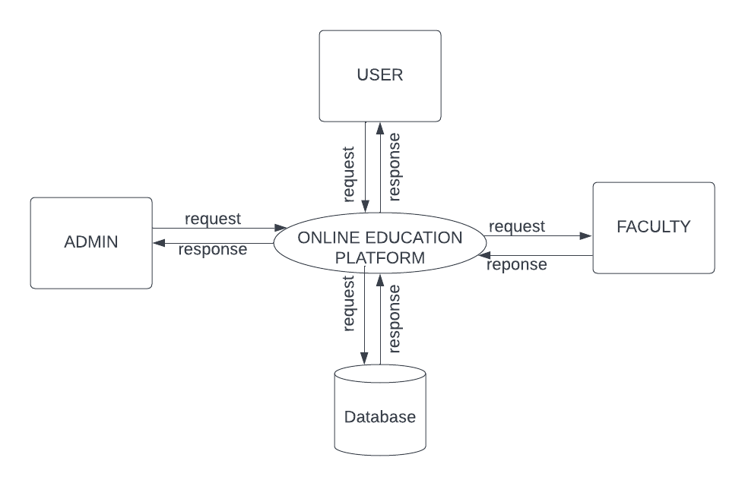
DATA FLOW DIAGRAM
LEVEL 1
The figure given above is for reference only. Create a figure with your data.

Slide 19
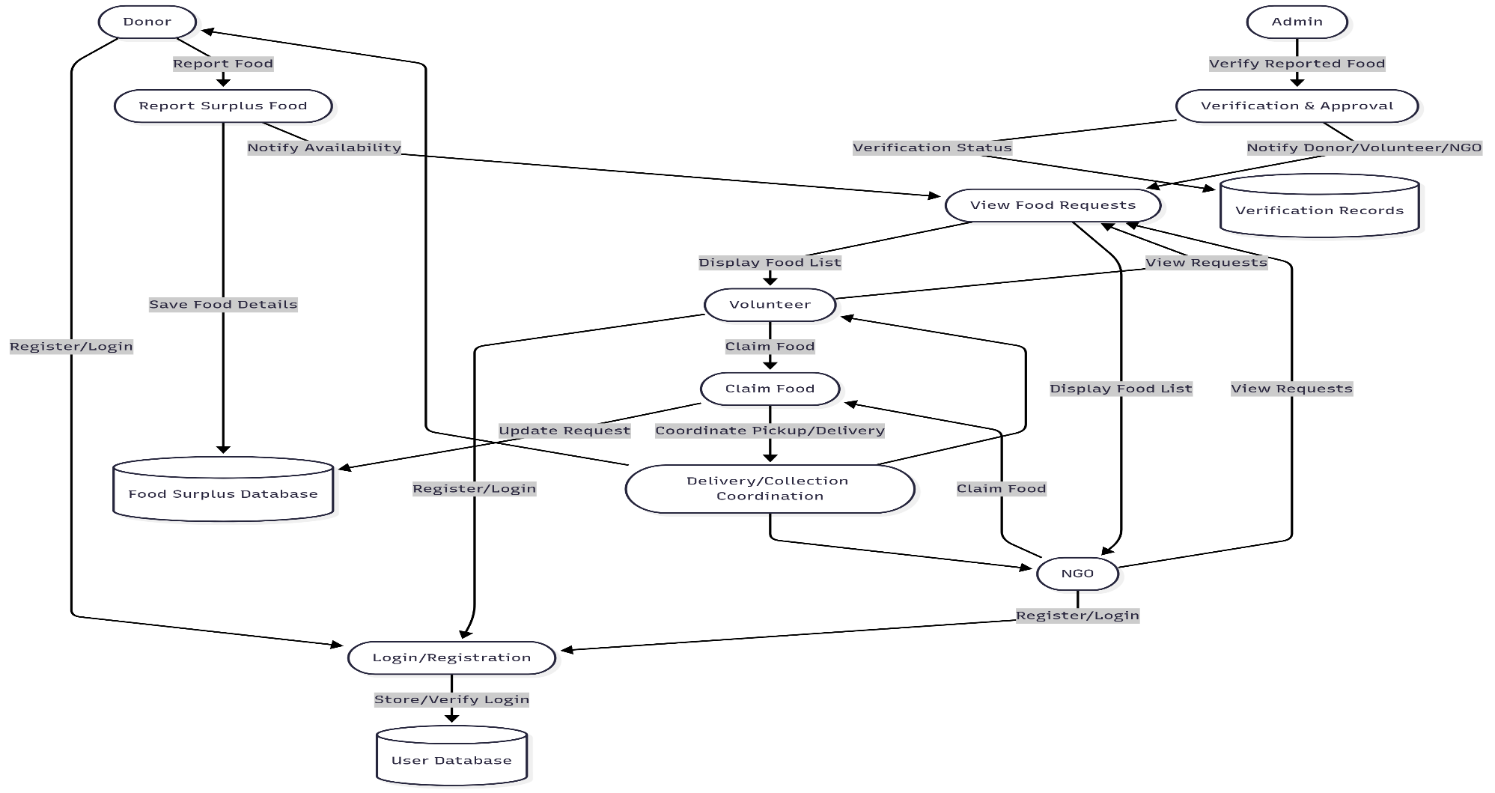
DATA FLOW DIAGRAM
Level 1.1

Slide 20
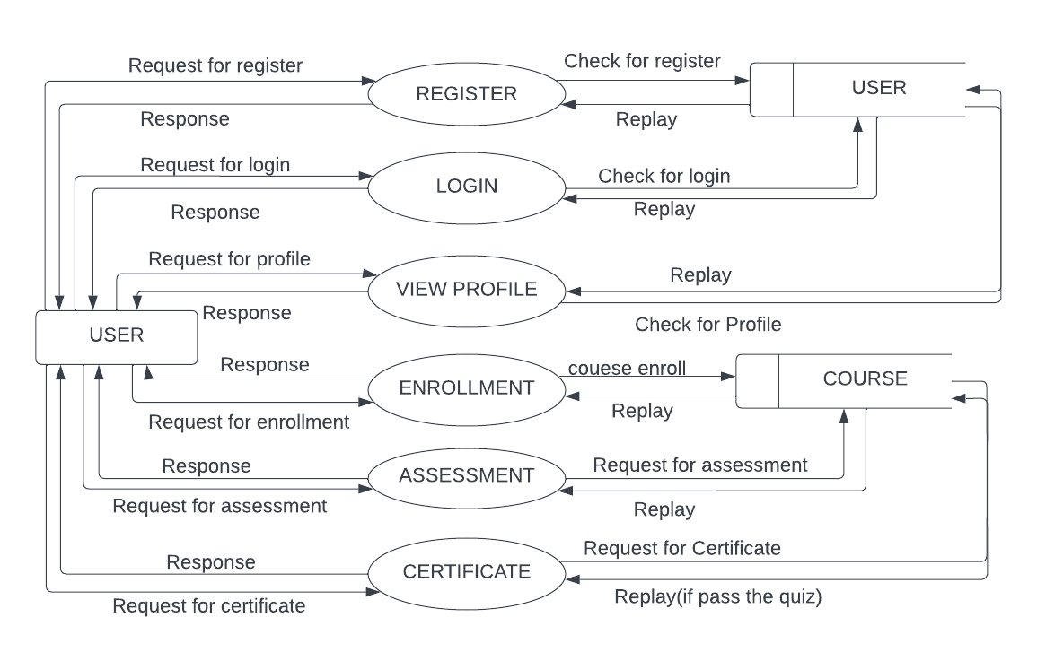
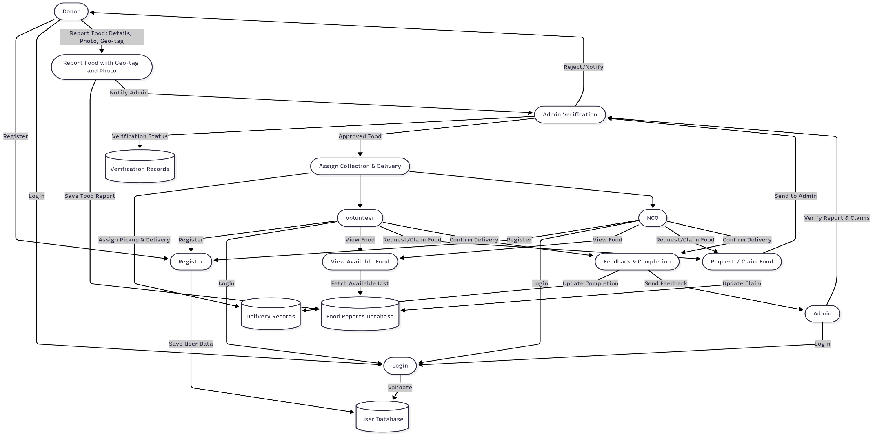
DATA FLOW DIAGRAM
Level 1.2
.

Slide 21
ER DIAGRAM
Place you ER Diagram (if any) here.

Slide 22
THANK YOU

